Slide 1

The Human Genome and Variation II Identification of genomic variants
授课老师：陈靖祺 副研究员
复旦大学类脑智能科学与研究院
2024年秋季学期

Slide 2
Genomic variation
Large
Small
Chromosomal abnormalities: e.g. trisomy; 45,X
Structural variation: e.g. deletion, duplication, translocation of a relatively long sequence
Base-level variation: SNP and InDels
How to detect?

Slide 3
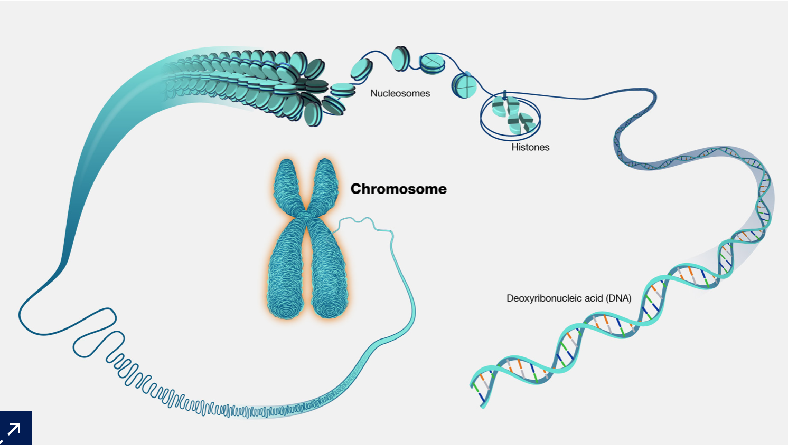
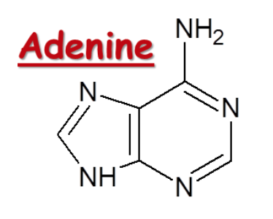
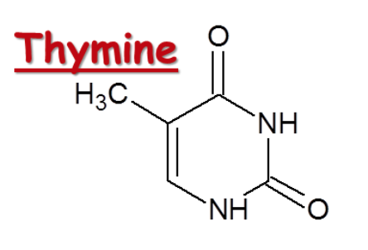
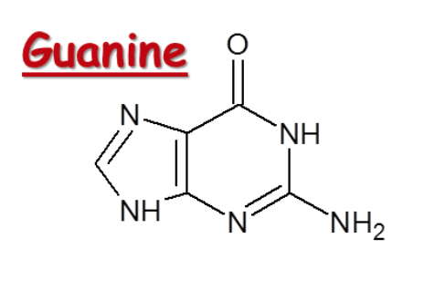
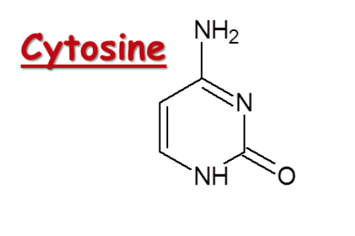
Review: DNA
腺嘌呤
胸腺嘧啶
鸟嘌呤
胞嘧啶
https://www.genome.gov/genetics-glossary/Chromosome
sliderbase.com

Slide 4
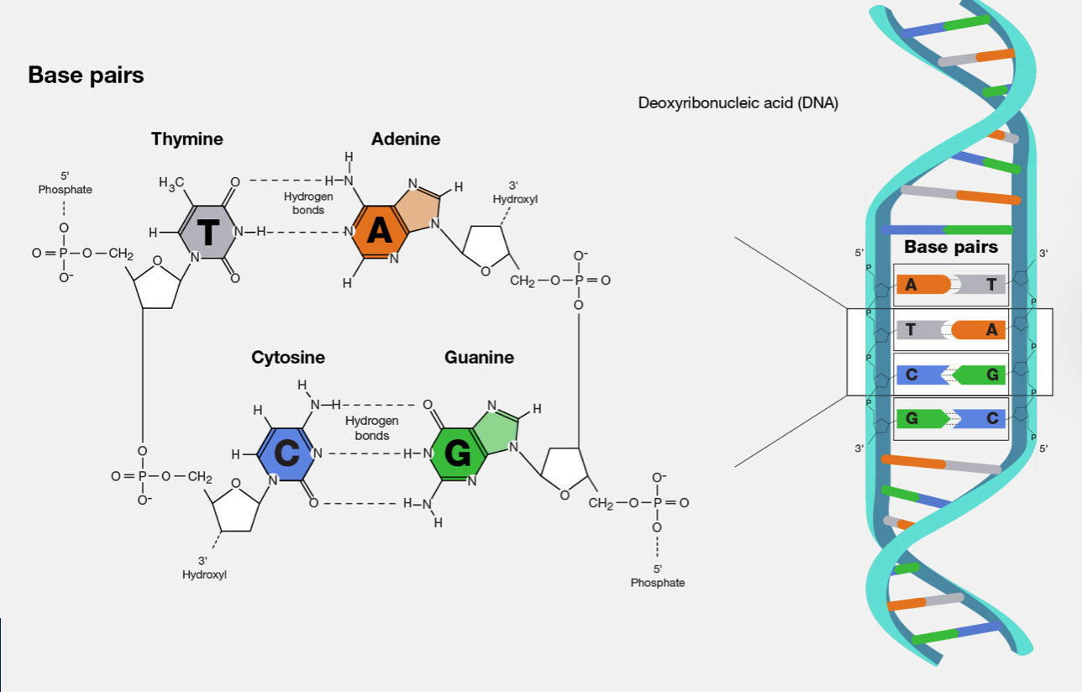
Review: DNA
https://www.genome.gov/genetics-glossary/Base-Pair

Slide 5
Genomic base-level variation
Single Nucleotide Polymorphism (SNP)
a variation at a single position in a DNA sequence among individuals
May or may not associate with disorders
Common SNPs(>1% or >5% population)
Rare SNPs (<1% or <5% population)
Small insertions and deletions (InDel), <50bp
In some definitions, <1kb
May or may not associate with disorders
https://www.nature.com/scitable/definition/snp-295/
https://www.sciencedirect.com/topics/medicine-and-dentistry/indel-mutation

Slide 6
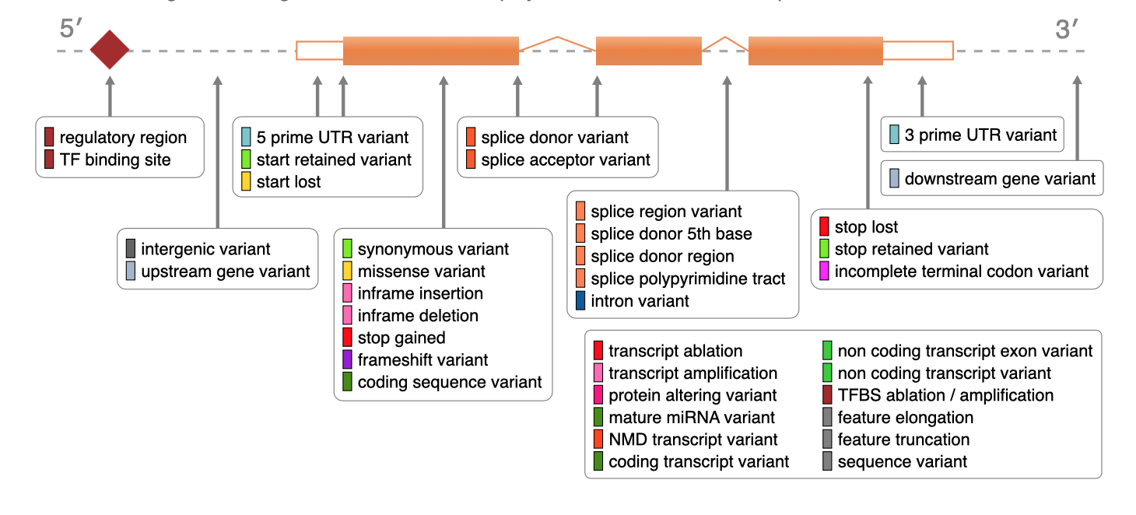
Genomic base-level variation
Possible consequences of SNPs/InDels
Relative to a coding gene:
Outside of coding genes:
Affect regulatory elements -> affect gene regulation
Affect noncoding RNAs etc.
http://mart.ensembl.org/info/genome/variation/prediction/predicted_data.html

Slide 7
Genomic structural variation
Structural Variant (SV), >50bp
Copy number variantion (CNV) (deletion, duplication), Insertion, Inversion, Translocation, Complex (a combination of multiple types)
SV, non-balanced
Ref genome
Case
Duplication 重复
Deletion 缺失
Insertion, 插入
SV, balanced
Ref genome
Case
Inversion, 倒位
Translocation, 易位

Slide 8
Genomic structural variation
Consequences of SV
Relative to a coding gene:
More severe impact than SNP due to the size
Outside of coding genes:
impact regulatoru elements (figure to the right)
Impact ncRNAs
Legend：
Regulatory
elements
gene
regulation
TAD boundary
(a)
(b)
(c)
Deletion
Deletion
Duplication
(d)
(e)
(f)
Insertion
(of a long sequence)
Insertion of a new regulatory element
Insertion
(g)
(h)
1
2
1
Inversion
Translocation
1
1
2
2

Slide 9
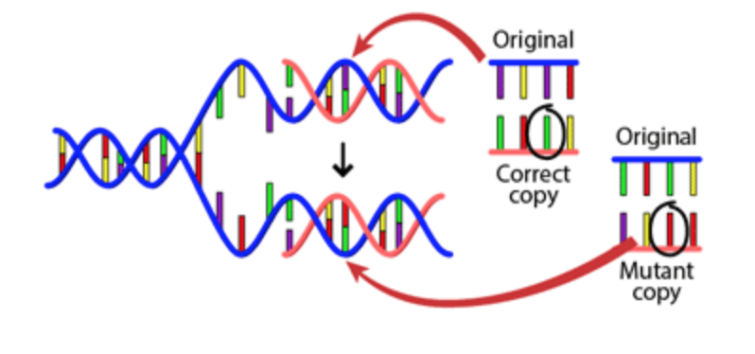
The sources of human genomic variants
During DNA Replication
If not corrected
Copied by further replications
Kept in the organism
https://evolution.berkeley.edu/evolution-101/mechanisms-the-processes-of-evolution/mutations/
Notes:
Mutations are the original source of genetic variation. A mutation is a permanent alteration to a DNA sequence. De novo (new) mutations occur when there is an error during DNA replication that is not corrected by DNA repair enzymes. It is only once the error is copied by DNA replication, and fixed in the DNA that it is considered to be a mutation. Mutations may be beneficial to the organism; deleterious (harmful) to the organism; or neutral (have no effect on the fitness of the organism). (https://www.ebi.ac.uk/training/online/courses/human-genetic-variation-introduction/what-is-genetic-variation/)

Slide 10
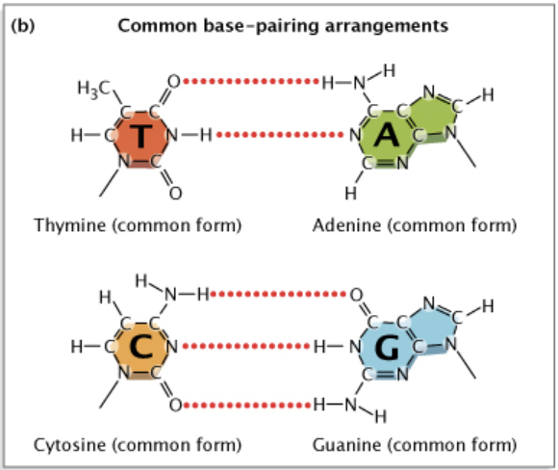
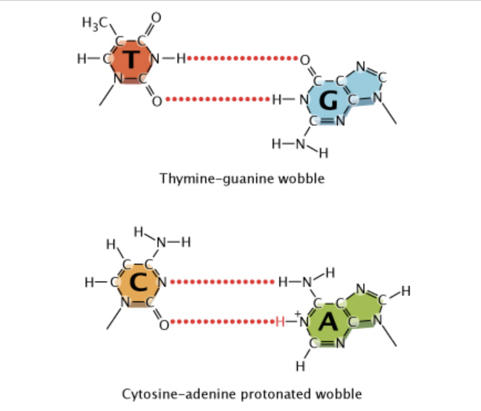
The sources of human genomic variants
During DNA Replication
“Wobble” mispairings
https://www.nature.com/scitable/topicpage/dna-replication-and-causes-of-mutation-409/

Slide 11
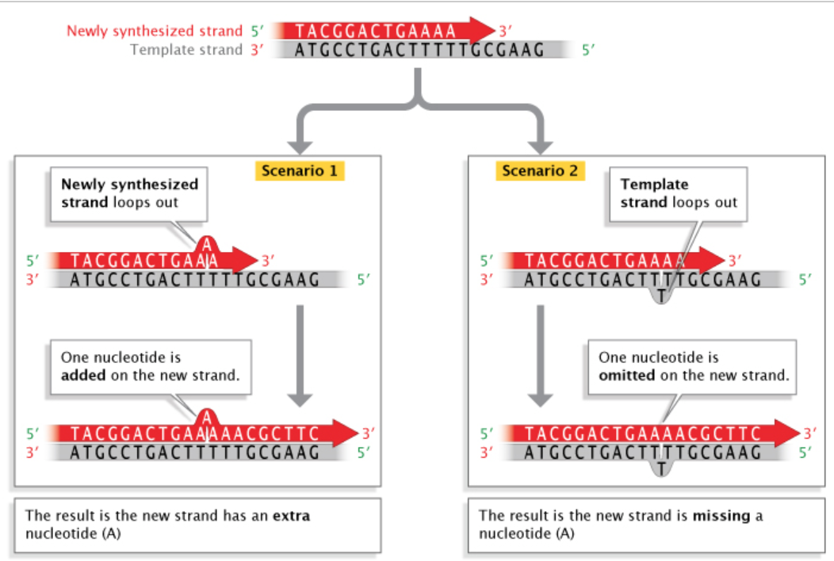
The sources of human genomic variants
During DNA Replication

Slide 12
The sources of human genomic variants
So, what is the error rate in DNA replication?
1 per every 100,000 nucleotides
1/100,000 * (3 billion *2) = 120,000 mistakes every time a cell divides !!
Though, many of them might be corrected through correction mechanisms.
https://www.nature.com/scitable/topicpage/dna-replication-and-causes-of-mutation-409/

Slide 13
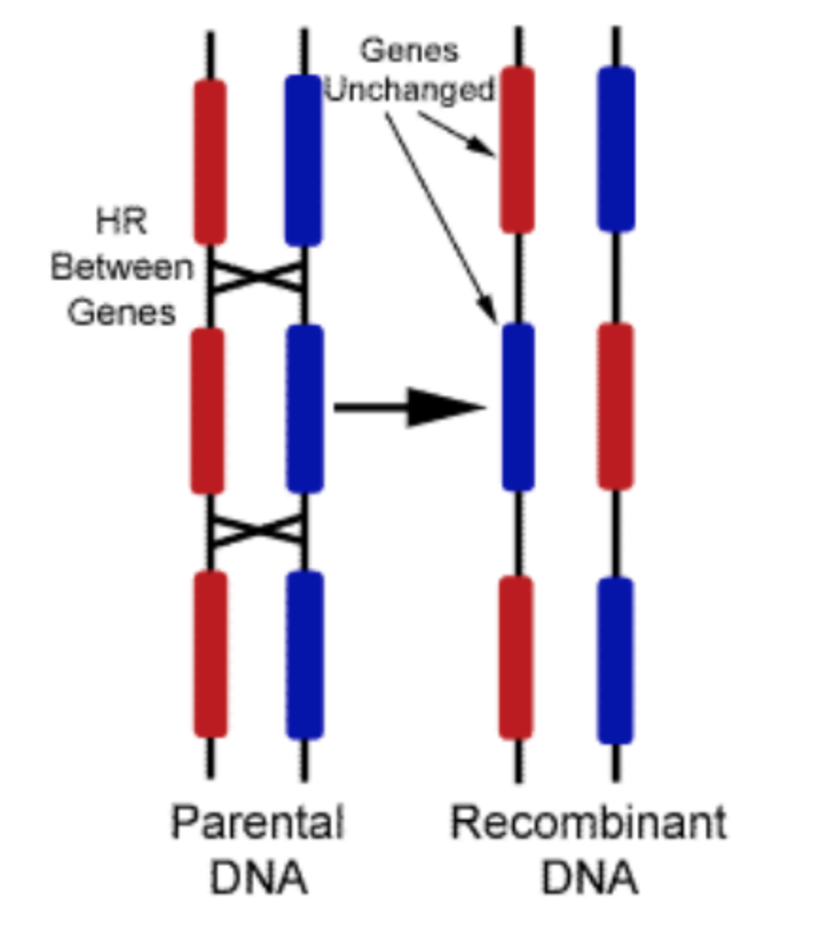
The sources of human genomic variants
During reproduction -> recombinations of sequences
http://creationwiki.org/File:Crossover.gif
Notes:
Recombination is another major source of genetic variation Each of us has a mixture of genetic material from our parents. The mixing of this genetic material occurs during recombination when homologous DNA strands align and cross over. Recombination effectively ‘shuffles’ maternal and paternal DNA, creating new combinations of variants in the daughter germ-cells. (https://www.ebi.ac.uk/training/online/courses/human-genetic-variation-introduction/what-is-genetic-variation/)

Slide 14
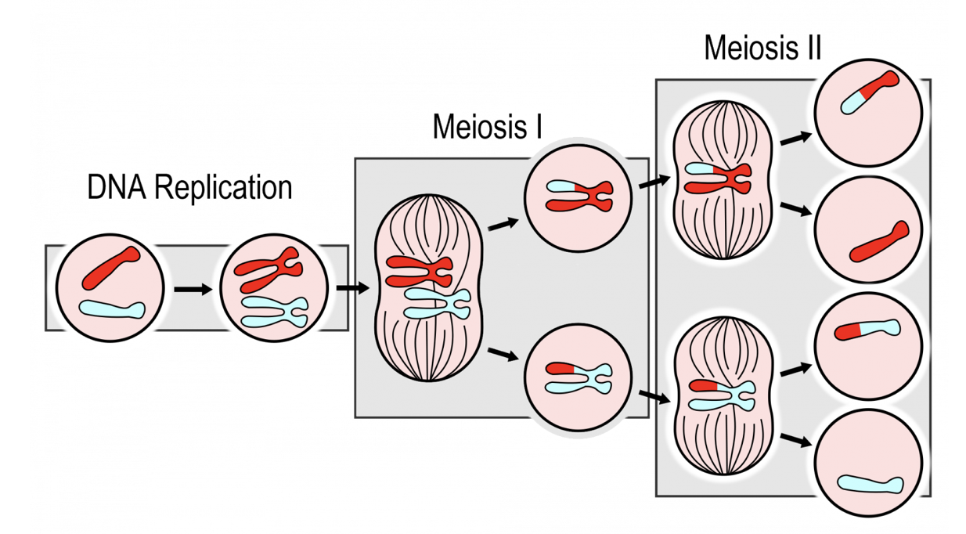
The sources of human genomic variants
During reproduction – recombination during meiosis
https://humanbiology.pressbooks.tru.ca/chapter/5-11-sexual-reproduction-meiosis-and-gametogenesis/

Slide 15
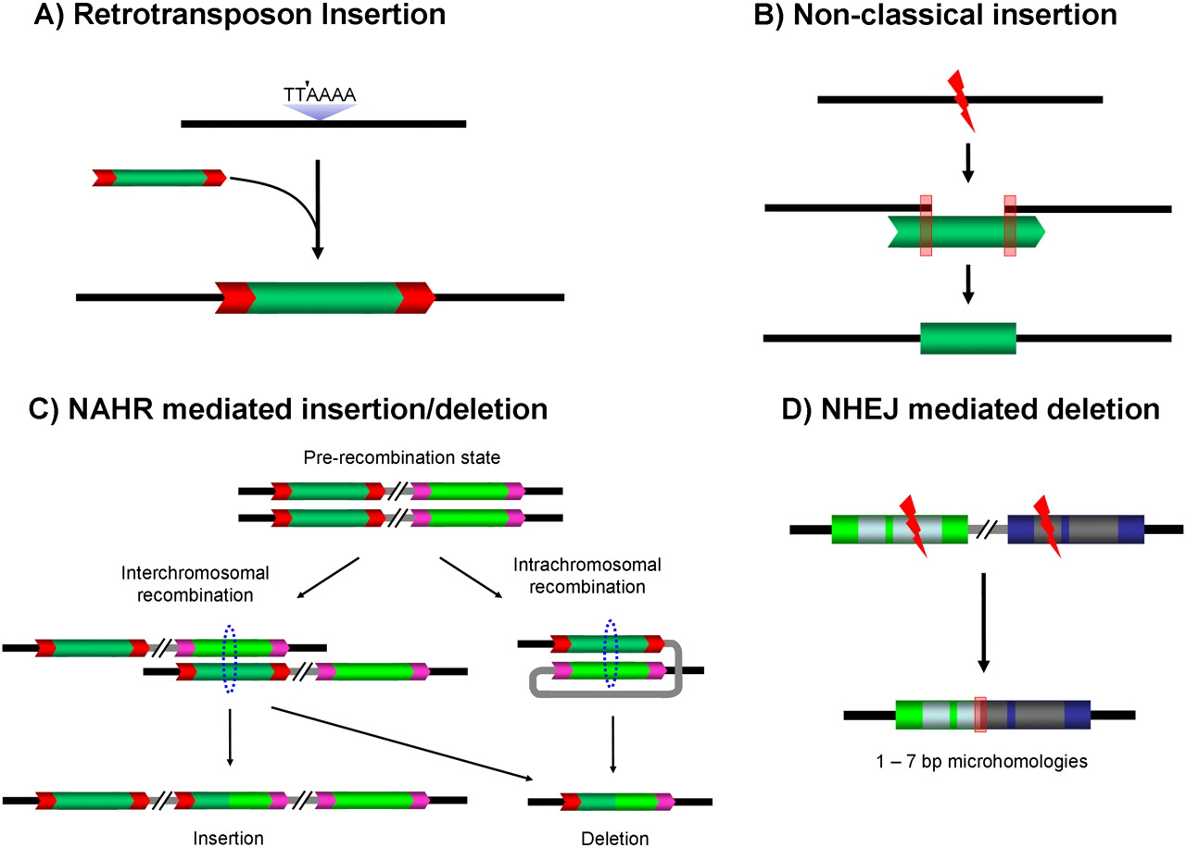

The sources of human genomic variants
Mobile elements
Four types of common mobile element-associated structural variants
Jinchuan Xing et al. Genome Res. 2009;19:1516-1526
Doi:10.1101/gr.091827.109
Notes:
Four types of common MASVs in the HuRef genome. (A) Classical retrotransposon insertion; (B) nonclassical insertions; (C) nonallelic homologous recombination-mediated insertion/deletion; (D) nonhomologous end-joining-mediated deletion. (TTAAAA) Standard L1 cleavage site for classical retrotransposition; (black lines) flanking regions, (gray lines) intervening regions, (dotted circles) homologous recombining regions, (red boxes) microhomology regions, (red arrow boxes) TSDs of each element.

Slide 16
The nature of human genomic variants
Germline variants
Exist in most cells in a person
Inherited from parents, or are denovo since germ cells/ fertilization/ very early stages of embryogenesis
Can be benign
Can lead to genetic disorders
Somatic variants
Exist in only a small portion of cells in a person (usually)
Orginated during or after embryogenesis, even in grown-ups
Can be benign
Can lead to diseases, e.g. cancer
Interesting fact: one can have somatic variants in one’s germ cells, sometimes leading to unexpected phonotypes in offsprings
Notes:
Somatic mutations can accumulate in our cells and are mostly harmless. They can lead to local changes in tissues such as moles appearing on the skin, and can also have more serious effects – for example leading to cancer. (https://www.ebi.ac.uk/training/online/courses/human-genetic-variation-introduction/what-is-genetic-variation/)

Slide 17
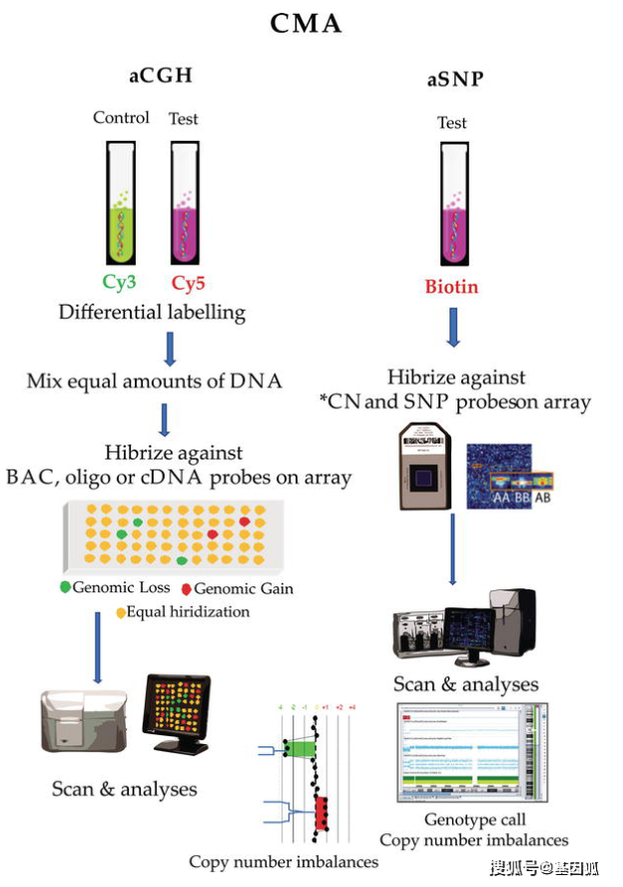
How to detect variants (big and small) on a genomic scale? (1)
Array-based
Chromosomal Microarray Analysis: CNV >1kb
array-based Comparative Genomic Hybridization (aCGH)
array Single Nucleotide Polymorphism (aSNP)
SNP chips: SNP/InDel
10^5 ~ 10^6 loci per genome
Widely used in Genome-wide association studies (GWAS)
https://www.sohu.com/a/387747007_120554400

Slide 18
How to detect variants (big and small) on a genomic scale? (2)
Sequencing
Low-throughput sequencing: Sanger sequencing
High-throughput sequencing: 2nd generation sequencing, 2.5 generation sequencing, 3rd generation sequencing… to be continued
Detects SNPs, InDels, SVs, and even Chromosomal abnormalities, across the whole genome (* relying on the resolution and coverage of the reference genome)

Slide 19
How to detect variants (big and small) on a genomic scale? (3)
Comparing array-based vs. sequencing techniques
 | Array-based | Sequencing
Coverage | Pre-designed spots of the genome | Whole genome (whole exome)
Advantage | Fast, precise, inexpensive (relatively) | Can found new / rare variants
Disadvantage | May miss important variants | Slow, Expensive (in both data generation and computing)
Setting | Clinically widely used | Research; start to be more prevalent in clinical settings

Slide 20
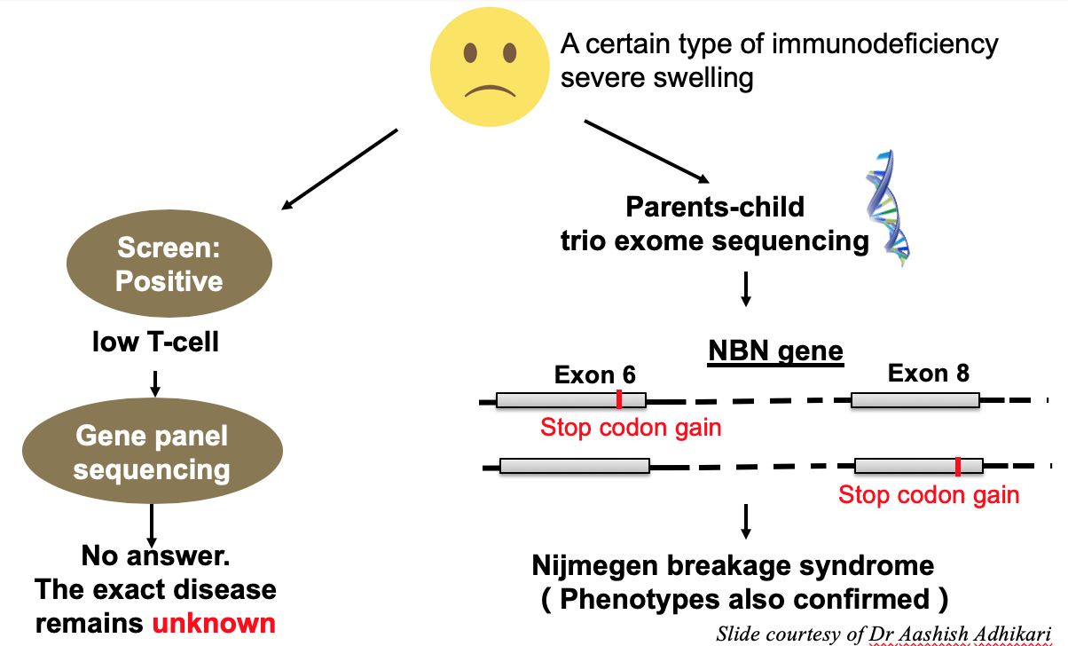
Example: the power of whole-exome sequencing
A sick child with primary immunodeficiency: what is the genetic cause?

Slide 21
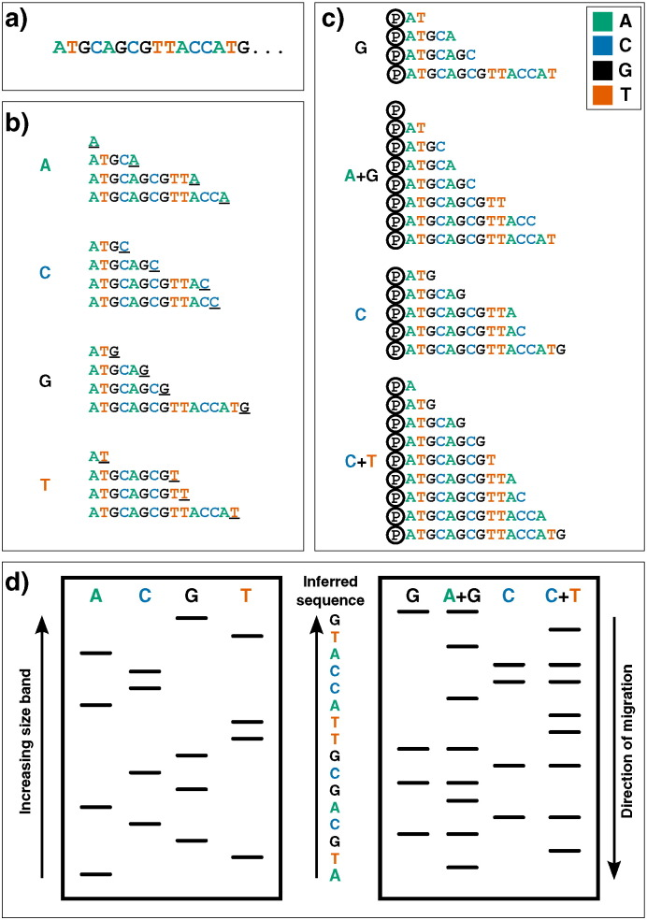
The development of sequencing technology (1)
First generation sequencing
Left: “Sanger” sequencing
‘chain-termination’ or dideoxy technique
Right: the Maxam and Gilbert technique
Using chemicals to break the chain at specific bases
Both developed in mid-1970s
Heather and Chain, Genomics. 2016;doi: 10.1016/j.ygeno.2015.11.003
Notes:
First-generation DNA sequencing technologies. Example DNA to be sequenced (a) is illustrated undergoing either Sanger (b) or Maxam–Gilbert (c) sequencing. (b): Sanger's ‘chain-termination’ sequencing. Radio- or fluorescently-labelled ddNTP nucleotides of a given type - which once incorporated, prevent further extension - are included in DNA polymerisation reactions at low concentrations (primed off a 5′ sequence, not shown). Therefore in each of the four reactions, sequence fragments are generated with 3′ truncations as a ddNTP is randomly incorporated at a particular instance of that base (underlined 3′ terminal characters). (c): Maxam and Gilbert's ‘chemical sequencing’ method. DNA must first be labelled, typically by inclusion of radioactive P ³² in its 5′ phosphate moiety (shown here by Ⓟ). Different chemical treatments are then used to selectively remove the base from a small proportion of DNA sites. Hydrazine removes bases from pyrimidines (cytosine and thymine), while hydrazine in the presence of high salt concentrations can only remove those from cytosine. Acid can then be used to remove the bases from purines (adenine and guanine), with dimethyl sulfate being used to attack guanines (although adenine will also be affected to a much lesser extent). Piperidine is then used to cleave the phophodiester backbone at the abasic site, yielding fragments of variable length. (d): Fragments generated from either methodology can then be visualized via electrophoresis on a high-resolution polyacrylamide gel: sequences are then inferred by reading ‘up’ the gel, as the shorter DNA fragments migrate fastest. In Sanger sequencing (left) the sequence is inferred by finding the lane in which the band is present for a given site, as the 3′ terminating labelled ddNTP corresponds to the base at that position. Maxam–Gilbert sequencing requires a small additional logical step: Ts and As can be directly inferred from a band in the pyrimidine or purine lanes respectively, while G and C are indicated by the presence of dual bands in the G and A + G lanes, or C and C + T lanes respectively.

Slide 22
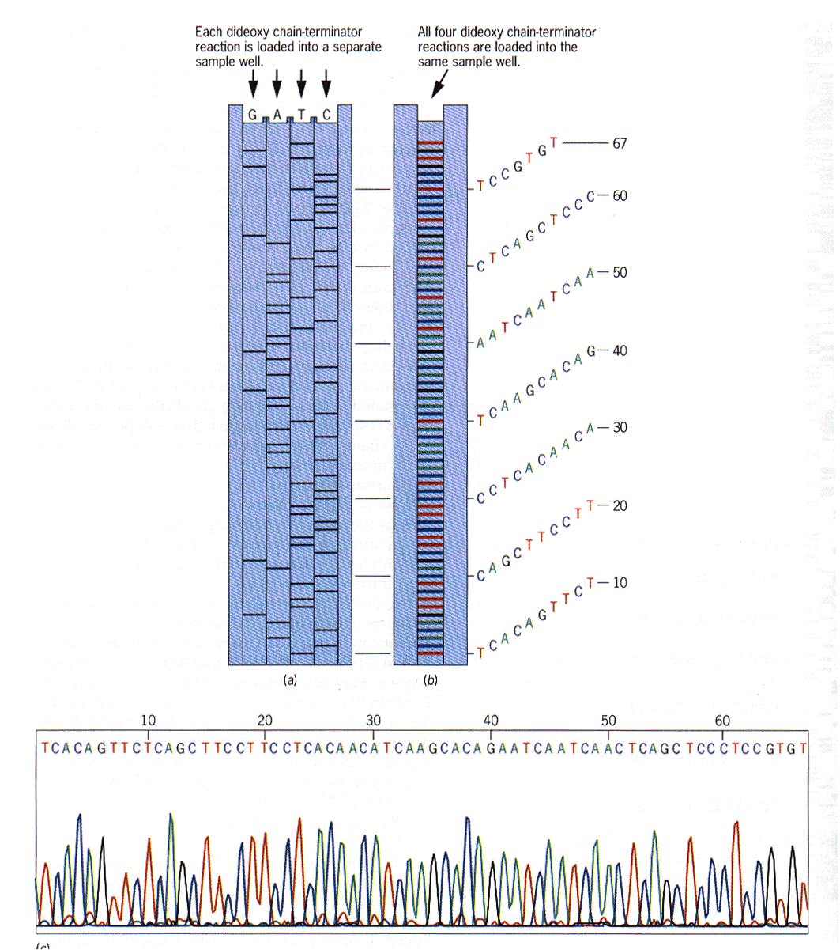

The development of sequencing technology (1->2)
新方法-提高效率、自动化
ddNTP用四种荧光分别标记
原方法
ddNTP用放射元素标记
Leroy Hood

Slide 23
The development of sequencing technology (2)
Second generation sequencing (“Next generation sequencing”)
the mass parallelization of sequencing reactions => making high-throughput sequencing possible
Most population techniques/platforms:
454 machine, called the GS 20, which was later superceded by the 454 GS FLX
Illumina Solexa and its successors (the most successful)
SOLiD from Applied Biosystems
“The capabilities of DNA sequencers have grown at a rate even faster than that seen in the computing revolution described by Moore's law: the complexity of microchips (measured by number of transistors per unit cost) doubles approximately every two years, while sequencing capabilities between 2004 and 2010 doubled every five months.”
Heather and Chain, Genomics. 2016;doi: 10.1016/j.ygeno.2015.11.003

Slide 24
Next Generation Sequencing, NGS (2nd generation sequencing) platforms: most common ones

Slide 25
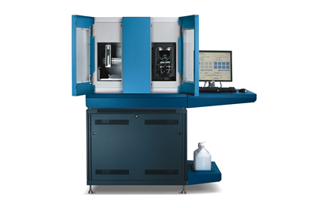
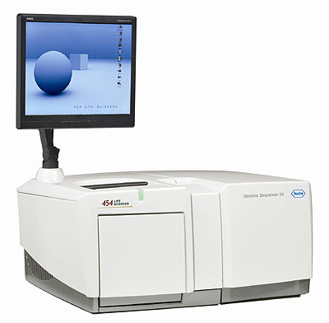
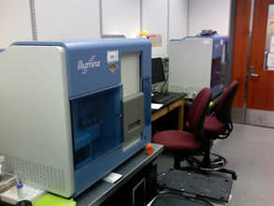
Next Generation Sequencing (2nd generation sequencing) platforms
Most common platforms
454
Illumina/Solexa
ABI-SOLID

Slide 26
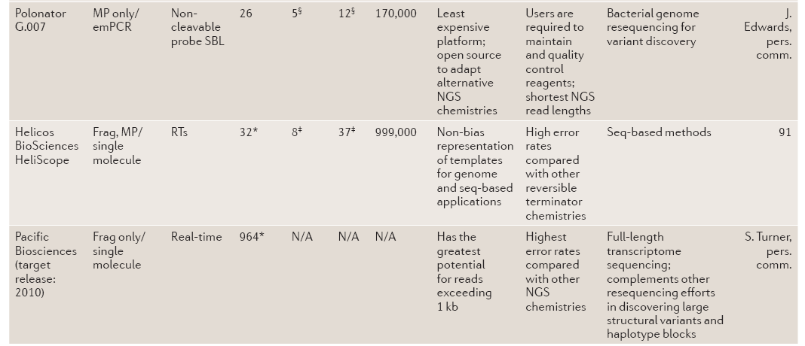
Next Generation Sequencing, NGS (2nd generation sequencing) platforms: others

Slide 27
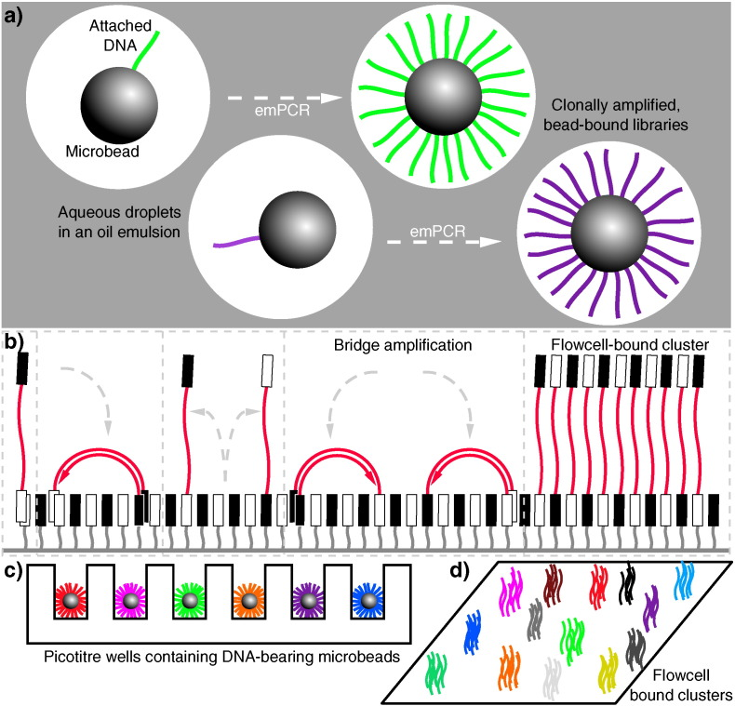
Next Generation Sequencing (2nd generation sequencing)
The conceptual basis
a&c) for 454
b&d) for Solexa/Illumina
Heather and Chain, Genomics. 2016;doi: 10.1016/j.ygeno.2015.11.003
Notes:
Second-generation DNA sequencing parallelized amplification. (a): DNA molecules being clonally amplified in an emulsion PCR (emPCR). Adapter ligation and PCR produces DNA libraries with appropriate 5′ and 3′ ends, which can then be made single stranded and immobilized onto individual suitably oligonucleotide-tagged microbeads. Bead-DNA conjugates can then be emulsified using aqueous amplification reagents in oil, ideally producing emulsion droplets containing only one bead (illustrated in the two leftmost droplets, with different molecules indicated in different colours). Clonal amplification then occurs during the emPCR as each template DNA is physically separate from all others, with daughter molecules remaining bound to the microbeads. This is the conceptual basis underlying sequencing in 454, Ion Torrent and polony sequencing protocols. (b): Bridge amplification to produce clusters of clonal DNA populations in a planar solid-phase PCR reaction, as occurs in Solexa/Illumina sequencing. Single-stranded DNA with terminating sequences complementary to the two lawn-oligos will anneal when washed over the flow-cell, and during isothermal PCR will replicate in a confined area, bending over to prime at neighbouring sites, producing a local cluster of identical molecules. (c) and (d) demonstrate how these two different forms of clonally-amplified sequences can then be read in a highly parallelized manner: emPCR-produced microbeads can be washed over a picotiter plate, containing wells large enough to fit only one bead (c). DNA polymerase can then be added to the wells, and each nucleotide can be washed over in turn, and dNTP incorporation monitored (e.g. via pyrophosphate or hydrogen ion release). Flow-cell bound clusters produced via bridge amplification (d) can be visualized by detecting fluorescent reversible-terminator nucleotides at the ends of a proceeding extension reaction, requiring cycle-by-cycle measurements and removal of terminators.

Slide 28
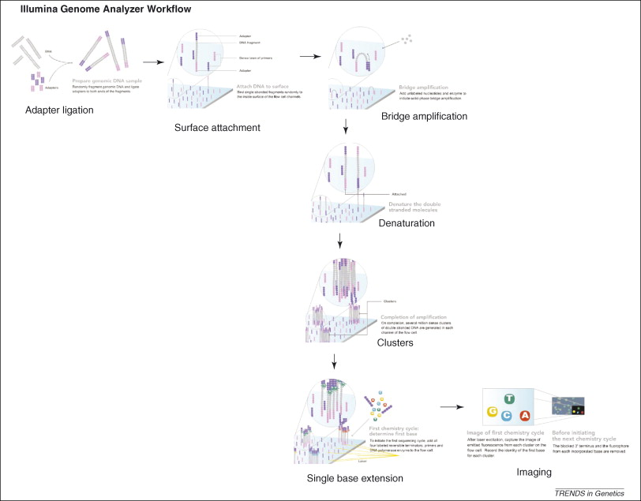
Illumina/Solexa

Slide 29
延伸知识 ：二代测序各大平台的通量比较
标准ABI “Sanger” 测序
每天24*96个样本
读段 (read)长度：~650 bp
每轮实验 (run): 7hr
总计= 450,000 碱基/日
454：“game changer”!
~400,000读段/日
读段长度：~250 bp (早期)，~330 bp (近年)
总计 = 100,000,000 碱基/日
Solexa (Illumina Genome Analyzer)
60,000,000读段
读段长度：36 bp (早期)，75~100bp (目前)
总计 = 40亿碱基/轮 (3天)
延伸阅读：
二代测序原理
https://zhuanlan.zhihu.com/p/77663085

Slide 30
延伸知识 ：二代测序各大平台的测序价格比较
2008:
Solexa: ~$6,000 per GB
ABI-SOLID: $6,000 per GB
454: $85,000 per GB
读段越长越有价值
人类基因组是3GB，但是1x coverage不能完成拼装
价格下降：2x per year
2020：
RNA-seq, ~RMB 150 per GB
Whole-genome re-sequencing, ~ $500-1000 per human genome (30X)

Slide 31
Next Generation Sequencing (2nd generation sequencing)
The main issue with 2nd generation sequencing: the short read lengths
Difficult for whole-genome assembly
Difficult to resolve repeat regions
Difficult to precisely identify structural variants
How to overcome this issue:
Higher coverage (read depths)
New algorithms
Longer read lengths!

Slide 32
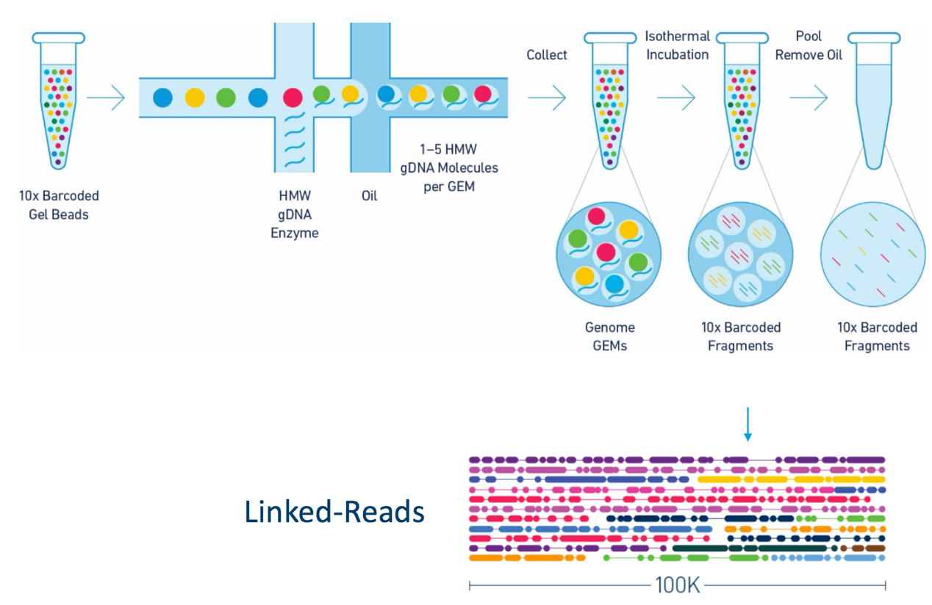
The development of sequencing technology (3)
“2.5-generation” sequencing by 10X Genomics
The read lengths are still short: 100-150bp
But reads from the same DNA fragments are marked by barcodes Thus the short reads from the same DNA fragments can be computationally assembled into “long reads” (“linked-reads”)
学有余力延伸阅读：
A hybrid approach for de novo human genome sequence assembly and phasing
https://www.nature.com/articles/nmeth.3865

Slide 33
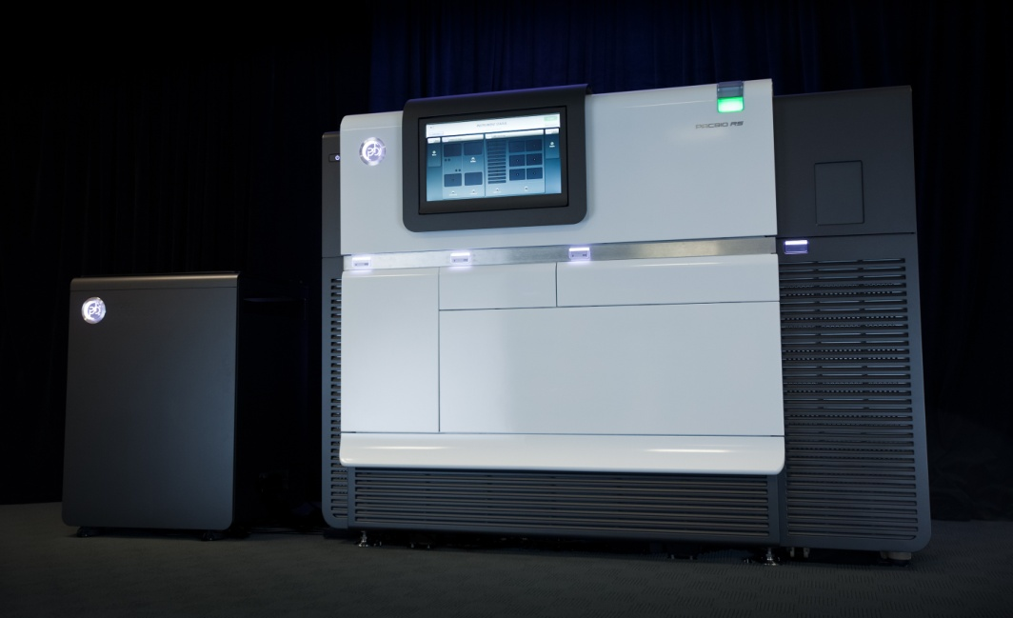
The development of sequencing technology (4)
Third-generation sequencing: Pacific BioSciences (PacBio)
DNA聚合酶固定
DNA单分子通过纳米尺度的小孔
“real-time” sequencing
Read length: 20k-30k (average)
延伸阅读：
三代测序原理
https://zhuanlan.zhihu.com/p/77663085

Slide 34
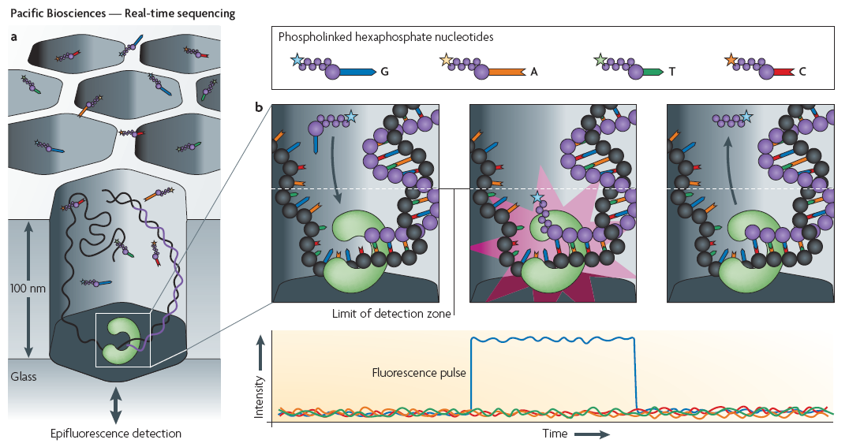
延伸知识：Pacific BioSciences

Slide 35
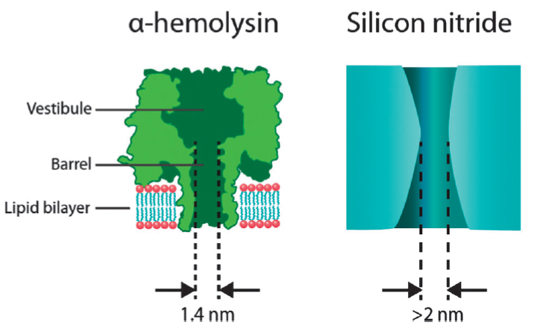
The development of sequencing technology (5)
Third-generation sequencing: Oxford Nanopore
通过纳米孔的单分子实时测序：single-molecule real-time
The diameter of DNA strand：B-DNA (2.0nm); A-DNA (2.6nm)
Nanopores：生物孔和材料孔
Read lengths 30k-40k (average)

Slide 36
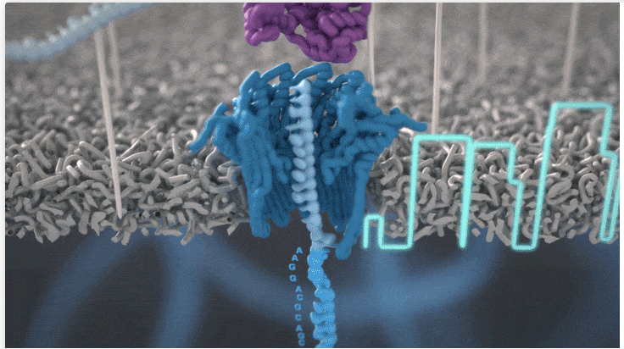
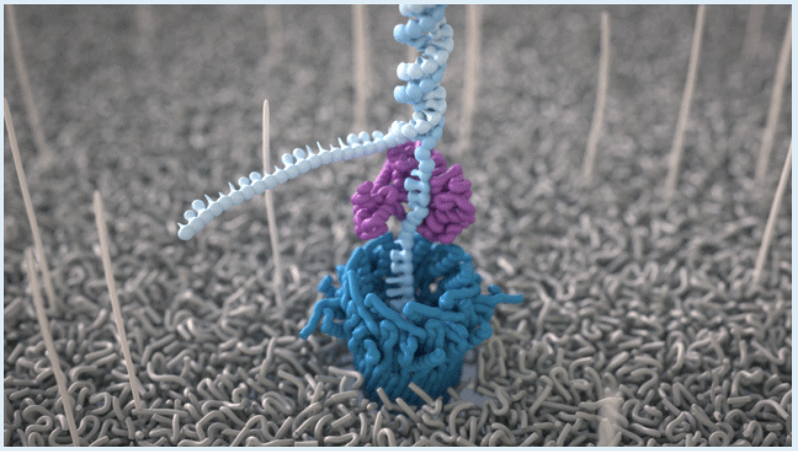
延伸阅读：Nanopore测序原理
https://nanoporetech.com/platform/technology#nanopores

Slide 37
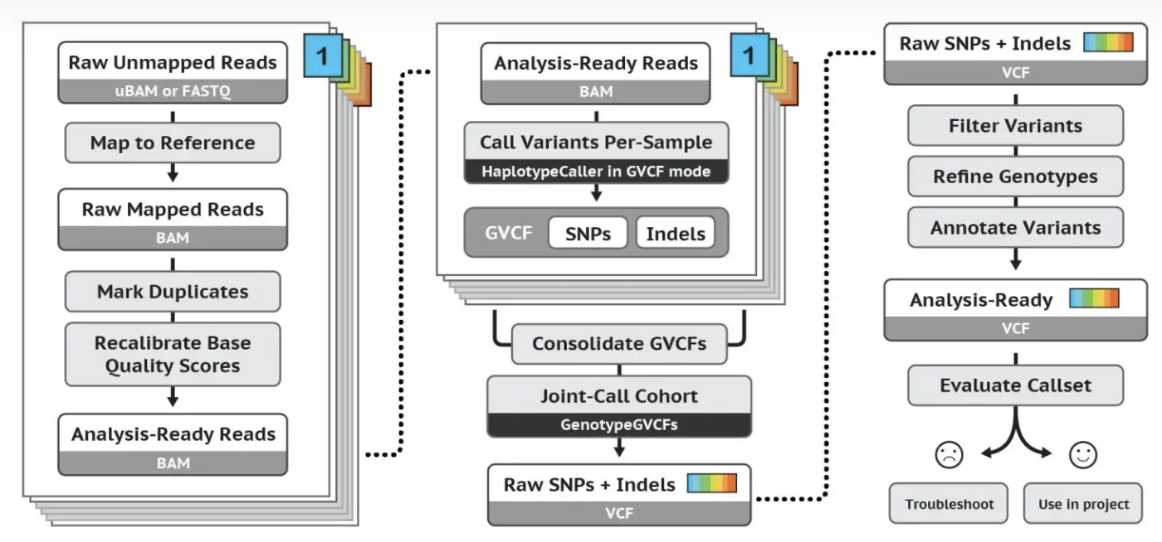
Determine genomic variants based on sequencing data
Short read sequencing, for SNP/InDel (1)
https://gatk.broadinstitute.org/hc/en-us

Slide 38
Determine genomic variants based on sequencing data
Short read sequencing, for SNP/InDel (2)
@E150005469L1C001R00200001102/1
CATGAAGTCAAGGCAGATATTACAACATGGGCTCTCATTCTTCTATGAGAGGAGAAATAAAGCATGCTCCGAGAGTGAAGACAAAAGTCATAAATTTTATTTACGTGTCCTCTCCTTCATTCATTTGTTCTACAAGCACTCATTAAATGT
+
DDDDDDDDDDDDDDDDDDDDDDDDDDDDDDDDDDDDDDDDDDDDDDDDDDDDDDDDDDDDDDDDDDDDDDDDDDDDDDDDDDDDDDDDDDDDDDDDDDDDDDDDDDDDDDDDDDDDDDDDDDDDDDDDDDDDDDDDDDDDDDDDDDDDDD
@E150005469L1C001R00200002861/1
CAAACAAGTAAGTGGAGAAGGAAGATTGCCTTCAAGAAGCTCTTCCAGTGGNTAGCTCATTGATCTCTAAATCTCTGTTAAAAGGATACCTCCTACCCAAAAAGGTCTTCTCTGACCTCCAGTTCTAAGTGGGAGAAGTGTTCCAAGTAT
+
DD9D,DD,9DD,9DDD99DD9DD,D,9D9DDDDDDD,D,DDDDDDDDDD9D!DD9,DDD9D9DD9D9DD9D99D,D9DDDDD9DD,,DD9D,DDD,DDDDDDDD,D,DD9D,9D,D,DDDDDD9DDD9DDD9D99DDDDDDD9,DD9,DD
FASTQ file format：
Every read have 4 lines:
“@” sequence ID
Sequence
“+” quality ID (sometimes same as sequence ID )
Quality score
Fastqsanger
Quality encoding: !"#$%&'()*+,-./0123456789:;<=>?@ABCDEFGHI
| | | | |
Quality score: 0 … 10 … 20 … 30 … 40

Slide 39
Determine genomic variants based on sequencing data
Short read sequencing, for SNP/InDel (3)
1. Map reads to reference
Software: BWA, Bowtie2
Primary algorithm: BWT (Burrows-Wheeler Transform)
Originally a compression algorithm, but its core idea can be used for sequence alignment
$TCTAC
C$TCTA
AC$TCT
TAC$TC
CTAC$T
TCTAC$
$TCTAC
AC$TCT
C$TCTA
CTAC$T
TAC$TC
TCTAC$
$TCTAC
AC$TCT
C$TCTA
CTAC$T
TAC$TC
TCTAC$
$TCTAC
CTATC$
Input
Cycling
Sorting
Last column
BWT output
C
AC
TAC
CTAC
TCTAC
$TCTAC
AC$TCT
C$TCTA
CTAC$T
TAC$TC
TCTAC$
$TCTAC
AC$TCT
C$TCTA
CTAC$T
TAC$TC
TCTAC$
$TCTAC
AC$TCT
C$TCTA
CTAC$T
TAC$TC
TCTAC$
$TCTAC
AC$TCT
C$TCTA
CTAC$T
TAC$TC
TCTAC$
$TCTAC
AC$TCT
C$TCTA
CTAC$T
TAC$TC
TCTAC$
Reverse transformation

Slide 40
扩展阅读
Use BWT to transform and index reference genome sequence
Align short reads
e.g.
r=CTA
map
TCTAC
CTA
CTA
CTA
$TCTAC
AC$TCT
C$TCTA
CTAC$T
TAC$TC
TCTAC$
$TCTAC
AC$TCT
C$TCTA
CTAC$T
TAC$TC
TCTAC$
$TCTAC
AC$TCT
C$TCTA
CTAC$T
TAC$TC
TCTAC$
TCTAC
Report sequence location
If matching fails, the tool may allow small errors like SNPs, insertions, or deletions for "tolerant" alignment.
Finally, output aligned sequence file BAM file.

Slide 41
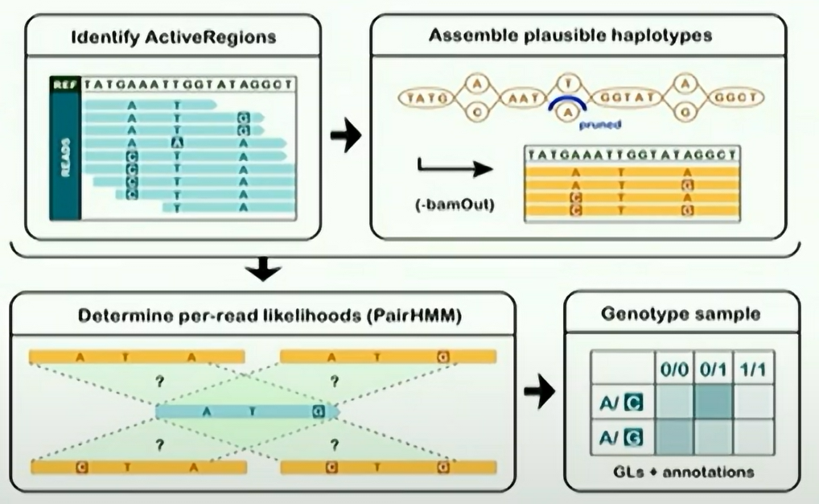
Determine genomic variants based on sequencing data
Short read sequencing, for SNP/InDel (4)
2. Variations calling:
Software: GATK HaplotypeCaller
Workflow:
FASTQ ->
BAM
GVCF
Poplin et al., bioRxiv, 2017; Doi: https://doi.org/10.1101/201178

Slide 42
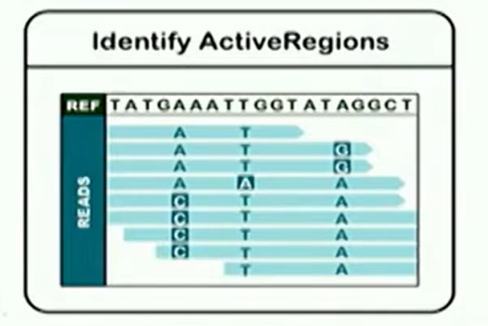
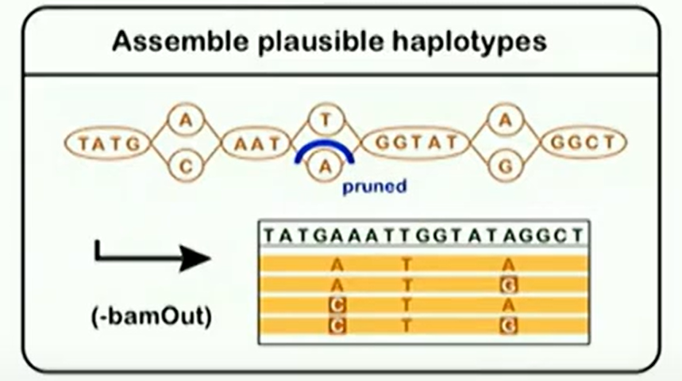
扩展阅读
Step1: Active Regions:
Mismatches
Indels
soft-clips
Step2: Assemble plausible haplotype:
Local realignment via graph assembly
De Bruijn Graph
Traverse graph to collect most likely haplotypes
Dijkstra’s algorithm
Align haplotypes to reference which will be used for genotyping
Smith-Waterman
Notes:
局部区域的重新组装

Slide 43
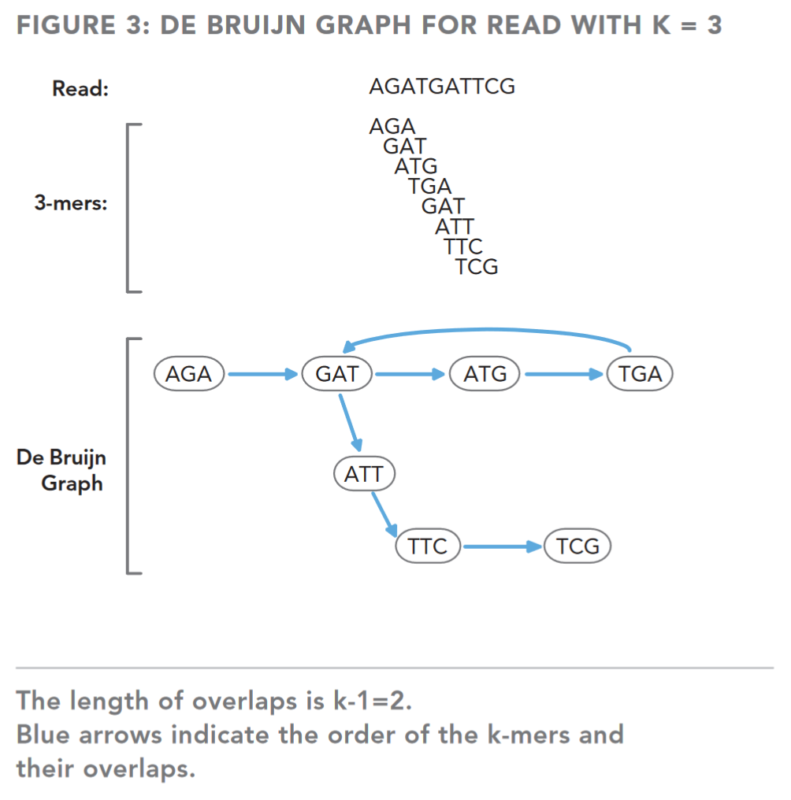
扩展阅读
Algorithm introduction 1:
De Bruijn Graph (DBG): a directed graph representing overlaps between sequences of symbols. (wikipedia)
DBG breaks reads into smaller sequences of DNA, called k-mers, where the parameter k denotes the length in bases of these sequences. The DBG captures overlaps of length k-1 between these k-mers and not between the actual reads
Note that:
K-mer size depends on the read length and error rate. There are some ways to select the appropriate k before realignment.
K-mer must be odd to avoid positive and antisense chain confusion. E.g. for ATAT, whose reverse compliment is ATAT. For ATA, whose reverse compliment is TAT.
TECHNICAL NOTE: ILLUMINA® SEQUENCING

Slide 44
扩展阅读
Algorithm introduction 2:
Dijkstra’s algorithm: solving single-source point (with only one starting point) with non-negative weight shortest path problem.
V2
Start | End | Predecessor | Shortest distance
V1 | V2 | V1 | 40
 | V3 | V2 | 45
 | V4 | V1 | 30
 | V5 | V3 | 70
 | V6 | V5 | 80
 | V7 | V6 | 130
20
25
70
V1
50
V3
50
V6
50
V7
40
25
30
70
55
V5
V4

Slide 45
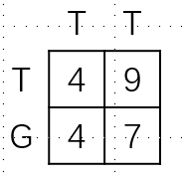
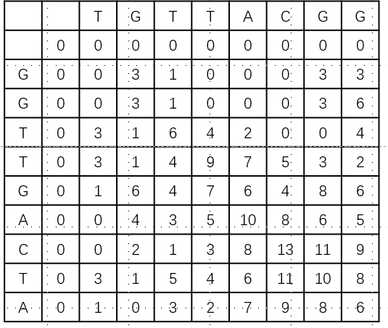
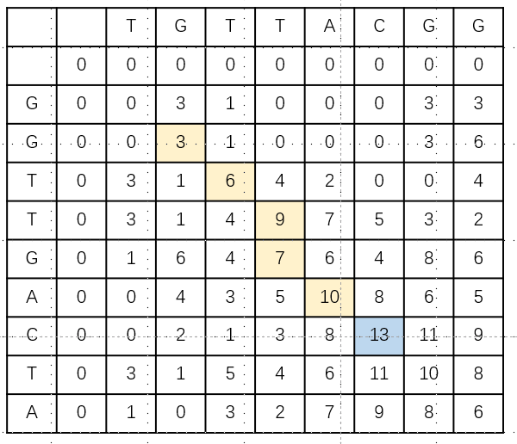
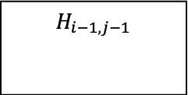
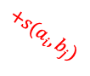
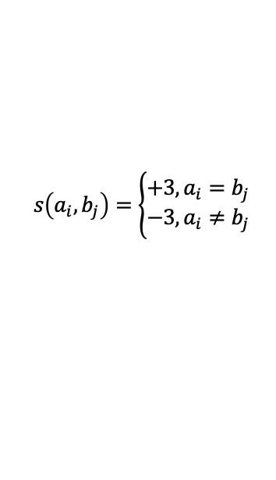


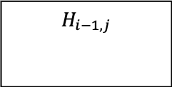
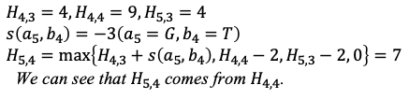
扩展阅读
Smith-Waterman: dynamic programming algorithm based on local matching
Score criteria definition:
E.g.: align the follow two sequence
TGTTACGG
GGTTGACTA
$$s\left(a_{i},b_{j}\right)=\left\{\begin{aligned}+3, a_{i}=b_{j} \\ −3, a_{i}≠b_{j}\end{aligned}\right.$$
$$H_{4,3}=4, H_{4,4}=9, H_{5,3}=4 \\ s\left(a_{5},b_{4}\right)=−3\left(a_{5}=G,b_{4}=T\right) \\ H_{5,4}=\max\left\{H_{4,3}+s\left(a_{5},b_{4}\right), H_{4,4}−2, H_{5,3}−2, 0\right\}=7$$
We can see that $H_{5,4}$ comes from $H_{4,4}$.
Penalty score matrix definition:
For example:
$$H_{i−1,j−1}$$
$$H_{i−1,j}$$
Initial value
$$+s(a_{i},b_{j})$$
$$−2$$
$$H_{i,j−1}$$
$$H_{i,j}$$
$$−2$$
-2 is penalty score
$$H_{i,j}=\max{\{H_{i−1,j−1}+s\left(a_{i},b_{j}\right), H_{i−1,j},−2, H_{i,j−1}−2, 0\}}$$
Initial value
Trace back local alignment sequence from maximum value and stop when reaches 0.
Local alignment sequence results:
GTT-AC
| | | | | |
GTTGAC

Slide 46
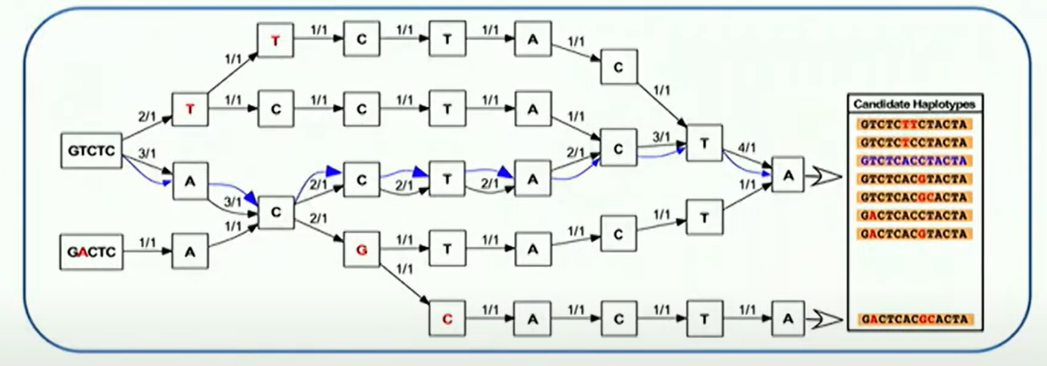
扩展阅读
Example: Assemble plausible haplotype
NOTE that: before traversing graph to sequence, we need simply graph:
Remove paths with low coverage
Merge simple linear paths
Solve small bubble structure
Ignore previous alignments
Graph consist of every possible sequence combination based on reads
Count reads that support paths
5-mer
reference sequence
Image source: GATK4
Align all candidate haplotypes to reference and determine mutation sites
DBG

Slide 47
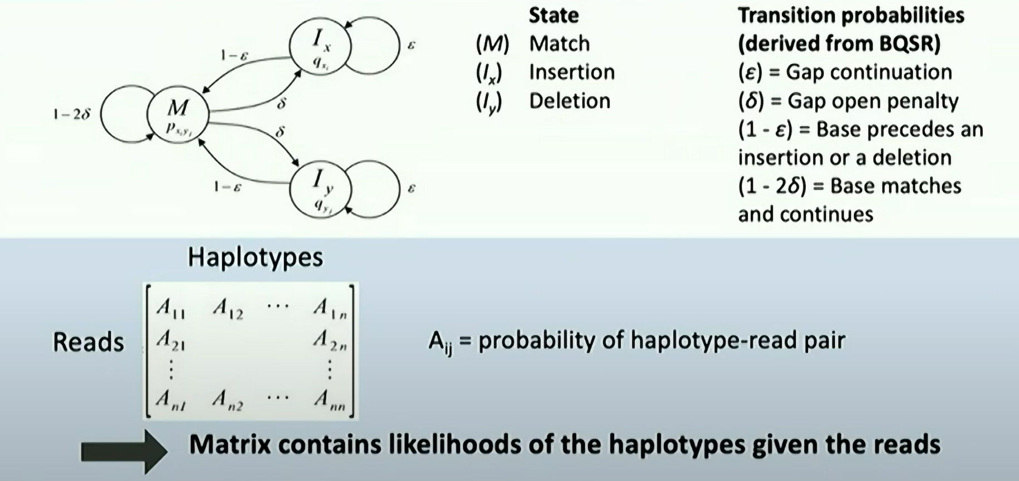
扩展阅读
Step3: Score haplotypes using PairHMM (Pair Hidden Markov Model)
Define transitions between the states as shown:
Image source: GATK4
E.g.
AG-TCA
AGGTC-
State path for this alignment: $MMI_{x}MMI_{y}$
The probability of this alignment:
$$P\left(A,A\right)∗\left(1−2δ\right)∗P\left(G,G\right)∗\left(1−2δ\right)∗Q_{x}\left(−,G\right)∗δ∗P\left(T,T\right)∗\left(1−2δ\right)∗P\left(C,C\right)∗\left(1−2δ\right)∗Q_{y}\left(A,−\right)∗δ$$
Produce a haplotype likelihoods matrix
Image source: GATK4

Slide 48
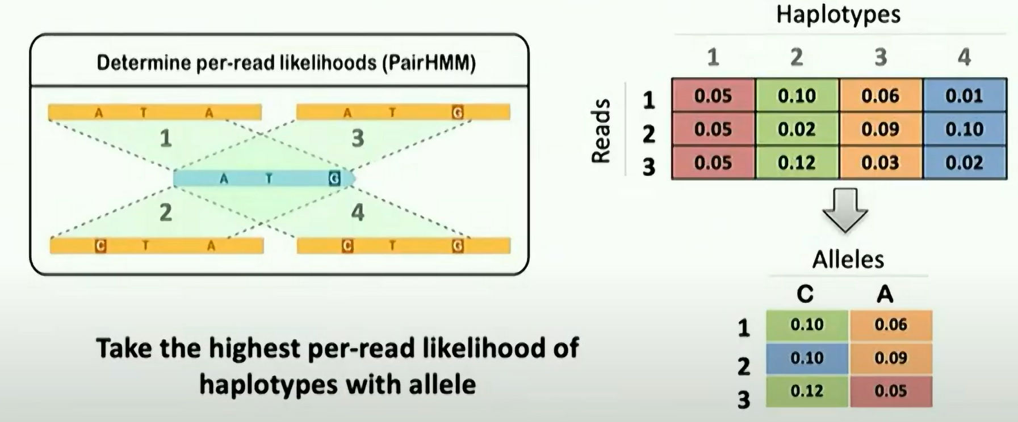
扩展阅读
Transforming support for haplotypes into support for alleles
Haplotype1
Haplotype3
read
Haplotype2
Haplotype4
Image source: GATK4

Slide 49
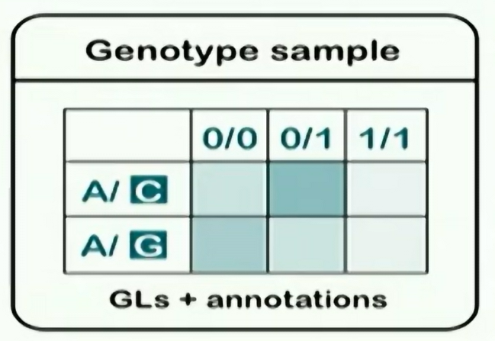
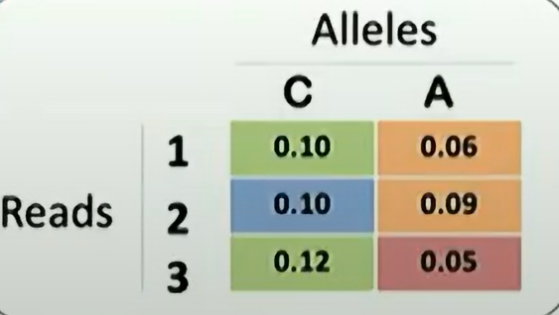
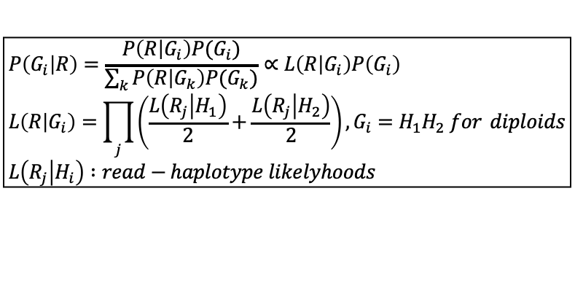
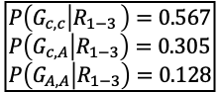


Step4: Genotype each sample at each potential variant sites
Apply Bayes’ theorem with ploidy assumption to determine the most likely genotype of the sample at each event in the haplotypes:
Posterior probability of the genotype given the reads
likelihood
$$P\left(G_{i} | R\right)=\frac{P\left(R | G_{i}\right)P(G_{i})}{\sum_{k}{P\left(R | G_{k}\right)P(G_{k})}}∝L\left(R | G_{i}\right)P\left(G_{i}\right) \\ L\left(R | G_{i}\right)=\prod_{j}{\left(\frac{L\left(R_{j} | H_{1}\right)}{2}+\frac{L\left(R_{j} | H_{2}\right)}{2}\right), G_{i}=H_{1}H_{2} for} diploids \\ L\left(R_{j} | H_{i}\right) :read−haplotype likelyhoods$$
Genotype prior (constant)
Example:
$$H1:C, H2:A \\ L\left(R_{1} | H_{1}\right)=0.10, L\left(R_{2} | H_{1}\right)=0.10, L\left(R_{3} | H_{1}\right)=0.12$$
$$L\left(R_{1} | H_{2}\right)=0.06 L\left(R_{2} | H_{2}\right)=0.09, L\left(R_{3} | H_{2}\right)=0.05$$
GVCF and index
$$L\left(R_{1−3} | G_{c,c}\right)=\frac{0.10+0.10}{2}+\frac{0.10+0.10}{2}+\frac{0.12+0.12}{2}=0.00120 \\ L\left(R_{1−3} | G_{c,A}\right)=\frac{0.10+0.06}{2}+\frac{0.10+0.09}{2}+\frac{0.12+0.05}{2}=0.00065 \\ L\left(R_{1−3} | G_{A,A}\right)=\frac{0.06+0.06}{2}+\frac{0.09+0.09}{2}+\frac{0.05+0.05}{2}=0.00027$$
Multiply by prior and divided by sum 0.002116
$$P\left(G_{c,c} | R_{1−3 }\right)=0.567 \\ P\left(G_{c,A} | R_{1−3}\right)=0.305 \\ P\left(G_{A,A} | R_{1−3}\right)=0.128$$

Slide 50
Determine genomic variants based on sequencing data
Short read sequencing, for SV (1)
SV, non-balanced
Review
Ref genome
Case
Duplication 重复
Deletion 缺失
Insertion, 插入
SV, balanced
Ref genome
Case
Inversion, 倒位
Translocation, 易位
To determine SVs, all the sequencing reads from a sample will first be aligned back to the reference genome (same as for SNPs), and then specific algorithms will resolve the breakends.

Slide 51
Determine genomic variants based on sequencing data
Short read sequencing, for SV (2)
Reads
Align to reference
BAM
Identify
Breakends
Graph-based
or
Non graph-based
Infer
Structural variants

Slide 52

Determine genomic variants based on sequencing data
Short read sequencing, for SV (3)
Manta:
* Local re-assembly
Chen et al., Bioinformatics, 2016; doi:10.1093/bioinformatics/btv710

Slide 53

Determine genomic variants based on sequencing data
Short read sequencing, for SV (3)
LUMPY:
Layer et al., Genome Biology, 2014; Doi: https://doi.org/10.1186/gb-2014-15-6-r84

Slide 54
Determine genomic variants based on sequencing data
Short read sequencing, for SV (4) mobile elements
MELT:
Discordant read pairs, where one mate maps to the reference genome and the other maps to an Alu, L1, or SVA reference mobile element sequence
Split reads
Candidate non-REF mobile element insertions (MEI)
Refinement
Alu, L1, and SVA MEIs
Gardner et al., Genome research, 2017; doi: 10.1101/gr.218032.116

Slide 55
Determine genomic variants based on sequencing data
Long read sequencing, for SNP/InDel (1)
Higher rate of base sequencing errors than short read sequencing, making it challenging to identify real SNP/InDel
Two common solutions
Deep learning based classification
Partitioning reads by haplotype
(to average out wrong calls)

Slide 56

Determine genomic variants based on sequencing data
Long read sequencing, for SNP/InDel (2)
DeepVariant:
Deep learning-based
Originally designed for short read sequencing
Can also be applied to long read sequencing
Poplin et al., Nature Biotechnology, 2018; Doi: https://doi.org/10.1038/nbt.4235

Slide 57

Determine genomic variants based on sequencing data
Long read sequencing, for SNP/InDel (2)
NanoCaller:
Using haplotype-aware deep neural networks
Ahsan et al., Genome Biology, 2021; Doi: https://doi.org/10.1186/s13059-021-02472-2

Slide 58

Determine genomic variants based on sequencing data
Long read sequencing, for SV (1)
Liu et al., Nature Communications, 2024; Doi: https://doi.org/10.1038/s41467-024-46614-z

Slide 59

Determine genomic variants based on sequencing data
Long read sequencing, for SV (2)
CuteSV2:
(alignment-based)
Jiang et al., bioRxiv; Doi: https://doi.org/10.1101/2022.08.29.505534
Notes:
Step 1. The signature extraction module is applied to comprehensively collect the signatures of various types of SVs. Step 2. All candidate signatures for each given SV are marked through specifically designed spatial similarity measurements and allele similarity estimation. Step 3. The overlapping alignment reads with given SVs are marked using the scanning line algorithm to acquire the detailed distribution of reads around SVs. Step 4. The genotype for each given SV on the corresponding sample is reassigned through maximum likelihood estimation.

Slide 60

Determine genomic variants based on sequencing data
Long read sequencing, for SV (3)
SVIM-asm:
(assembly-based)
Heller and Vingron, Bioinformatics, 2020; doi: 10.1093/bioinformatics/btaa1034

Slide 61


Determine genomic variants based on sequencing data
Long read sequencing, for SV (4)
SVision:
Image and neural network-based
Lin et al., Nature Methods, 2022; Doi: https://doi.org/10.1038/s41592-022-01609-w
Notes:
a, Overview of three modules in SVision. b, Workflow for each module.

Slide 62

Determine genomic variants based on sequencing data
Long read sequencing, benchmarking (1)
For standard types of SVs:
SV callers:
Alignment methods:
Liu et al., Genome Biology, 2024; Doi: https://doi.org/10.1186/s13059-024-03324-5

Slide 63

Determine genomic variants based on sequencing data
Long read sequencing, benchmarking (2)
For complex SVs:
Lin et al., Nature Methods, 2022; Doi: https://doi.org/10.1038/s41592-022-01609-w

Slide 64
One big issue: how reliable are the variants?
Ideally, bioinformaticians should get involved from the beginning, e.g. the design of the study and the collecting of the samples.
Often, however, bioinformaticians only get involved when the data have already been generated from a sequencing machine.
So, how do we determine the quality of data and the reliability of the identified variants?

Slide 65
Quality control (1): based on the sequenced reads
FastQC: a quality control tool for high throughput sequence data
Reads
(fastq formats)
FastQC
QC reports
Problem?
Downstream analyses
Yes
No
Further processes: trim reads, remove reads, etc.

Slide 66

Quality control (1): based on the sequenced reads
FastQC
https://www.bioinformatics.babraham.ac.uk/projects/fastqc/

Slide 67




Quality control (1): based on the sequenced reads
FastQC
Per Sequence Quality Scores
Per Base Sequence Content
Per Base GC Content
Per Sequence GC Content
https://mugenomicscore.missouri.edu/PDF/FastQC_Manual.pdf

Slide 68




Quality control (1): based on the sequenced reads
FastQC
Per Base N Content
Sequence Length Distribution
Duplicate Sequences
Overrepresented Kmers
https://mugenomicscore.missouri.edu/PDF/FastQC_Manual.pdf

Slide 69
Quality control (2): based on the identified variants
For sample inclusion/exclusion:
Gender estimation: indication of problems if different from the sample information
Kinship analysis: indication of problems if different from the sample information
Mutation rate/quantity: outliers indicating sample quality issues
Contamination analysis: indication of contamination
Fraction of high-quality variants: outliers indicating sample quality issues (high-quality SNPs: e.g. GQ>20)
Various tools can perform the above analyses.

Slide 70

Quality control (3): validation of certain variants
(a) Visual check
IGV: Integrative genomics viewer
Robinson et al., Nature Biotechnology, 2011; Doi: https://doi.org/10.1038/nbt.1754
Notes:
Coverage plot and alignments from paired-end reads for a matched tumor/normal pair. Sequencing was performed on an Illumina (San Diego, CA) GA2 platform and aligned with Maq (http://maq.sourceforge.net/). Alignments are represented as gray polygons with reads mismatching the reference indicated by color. Loci with a large percentage of mismatches relative to the reference are flagged in the coverage plot as color-coded bars. Alignments with unexpected inferred insert sizes are indicated by color. There is evidence for a ∼10-kb deletion (removing two exons of AIDA) in the tumor sample not present in the normal.

Slide 71

Quality control (3): validation of certain variants
(b) Machine-learning based methods
Collins et al., Nature, 2020; Doi: https://doi.org/10.1038/s41586-020-2287-8

Slide 72
Quality control (3): validation of certain variants
(c) Sanger sequencing
Arguably, the “golden standard” for validating variants
Limitations:
Length up to ~800-900bp
Has difficulty reading through short repeat sequences
(d) Capillary electrophoresis
For repeat sequences such as tandem repeats (sometimes difficult to sequence due to the high repetitive nature)

Slide 73
Summary
The sources of human genomic variants
Ways to detect genomic variants
Sequencing technologies at a glance
Sequencing-based methods for identifying genomic variants
+ how to do quality control

